Slide 1
Analyzing and Storing Logs

Slide 2
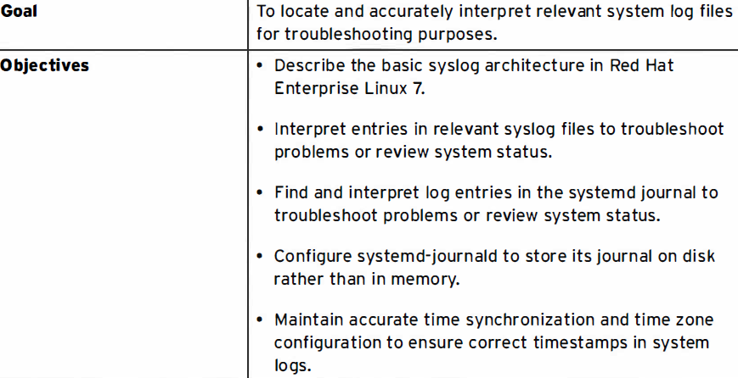

Slide 3
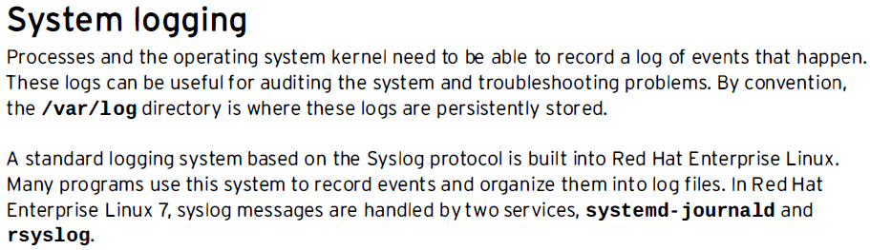
System Log Architecture

Slide 4
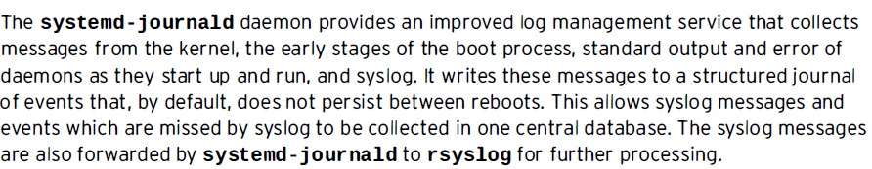
System Log Architecture

Slide 5
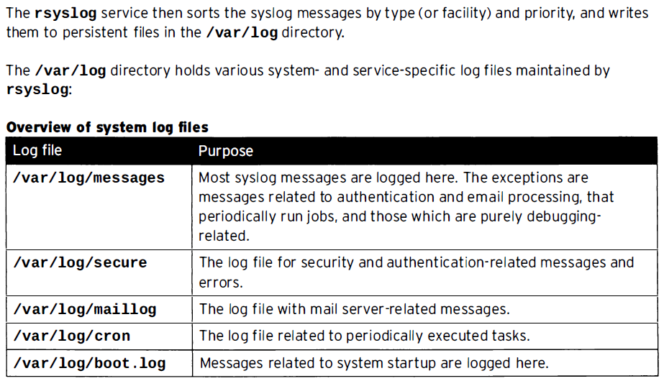
System Log Architecture

Slide 6
System Log Architecture

Slide 7
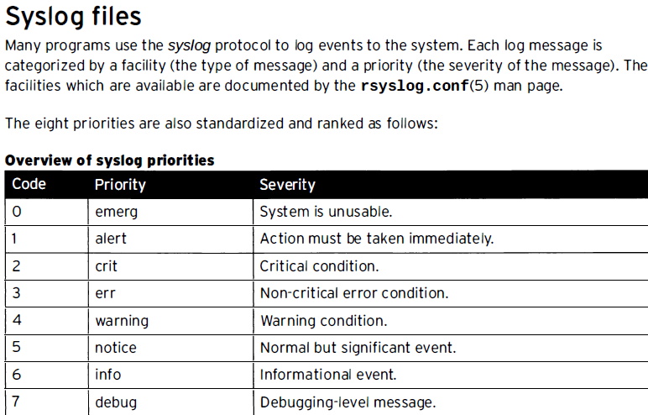
Reviewing Syslog Files

Slide 8
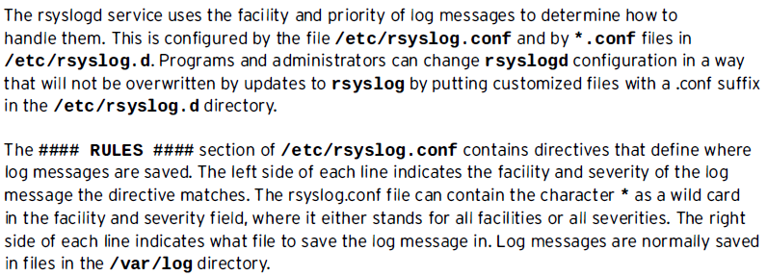
Reviewing Syslog Files

Slide 9
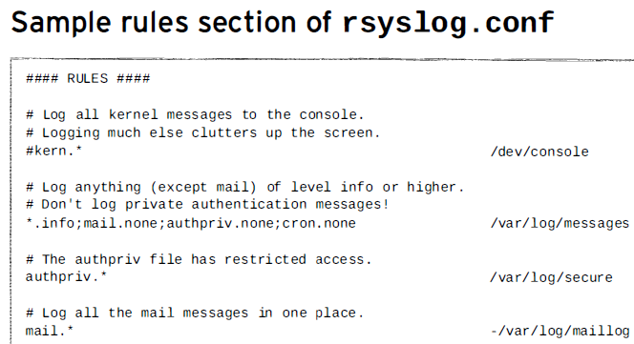
Reviewing Syslog Files

Slide 10
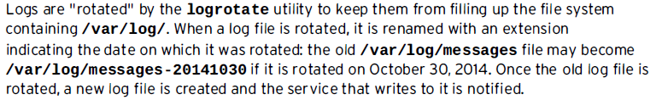
Log file rotation

Slide 11
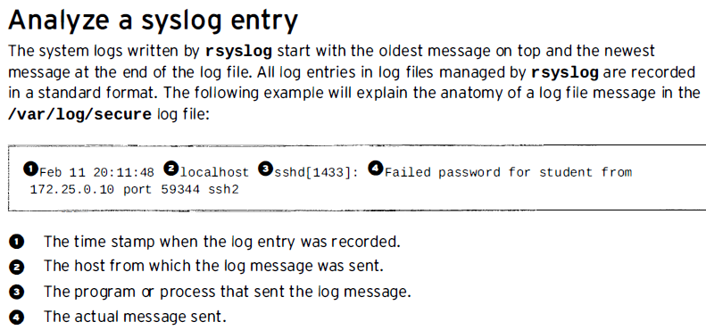
Log file rotation

Slide 12
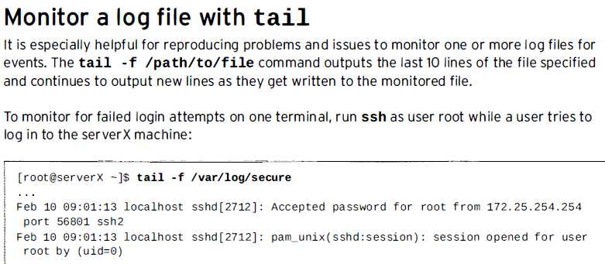
Log file rotation

Slide 13
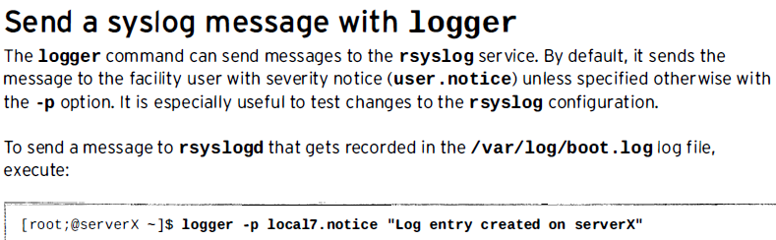
Log file rotation

Slide 14
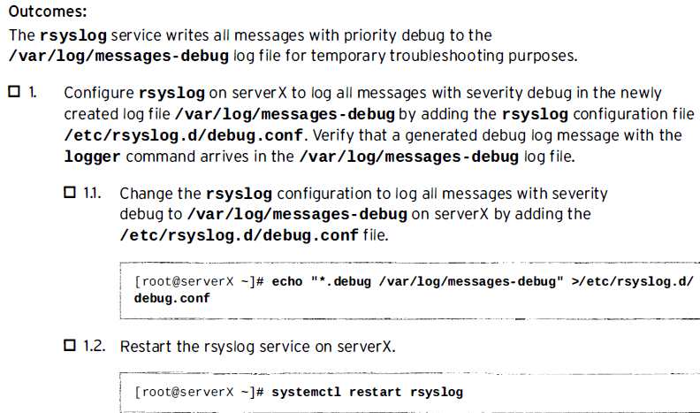
Practice : Finding Log Entries

Slide 15
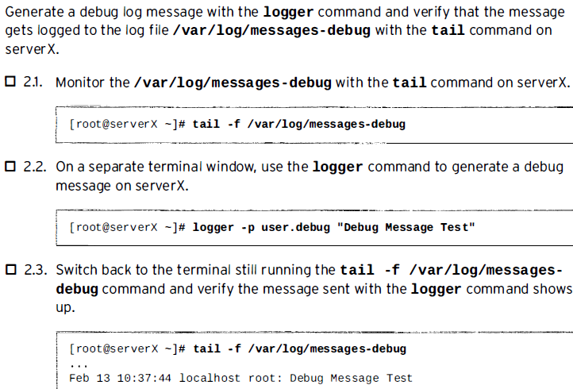
Practice : Finding Log Entries

Slide 16
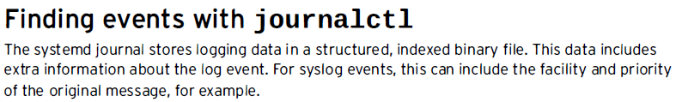
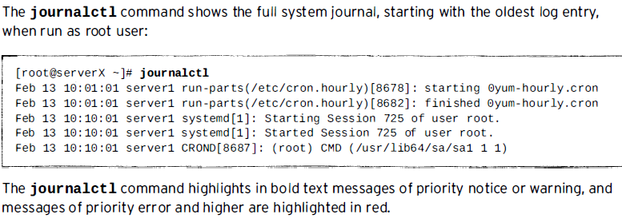
Reviewing systemd Journal Entries

Slide 17
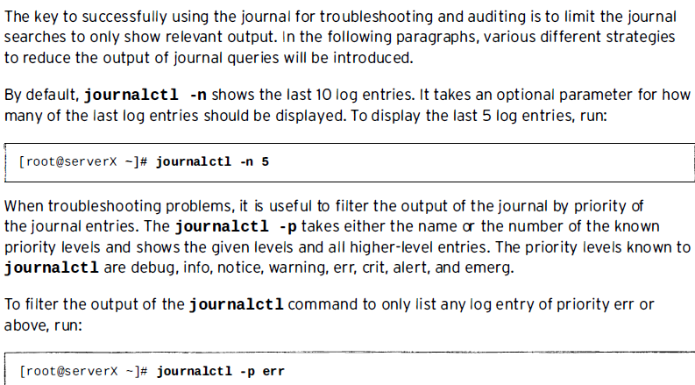
Reviewing systemd Journal Entries

Slide 18
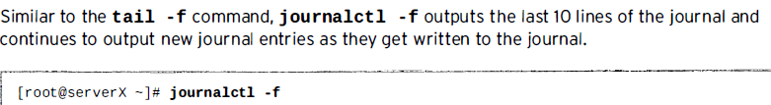
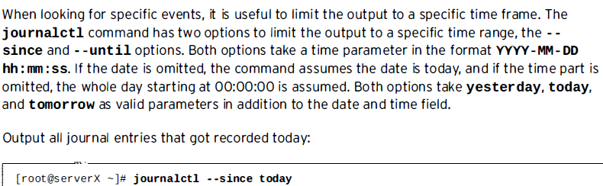
Reviewing systemd Journal Entries

Slide 19

Reviewing systemd Journal Entries
Explore:

Slide 20
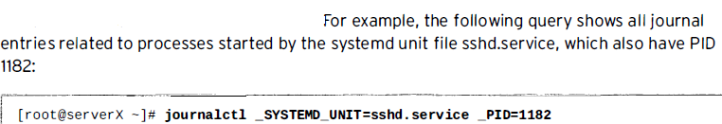
Reviewing systemd Journal Entries

Slide 21
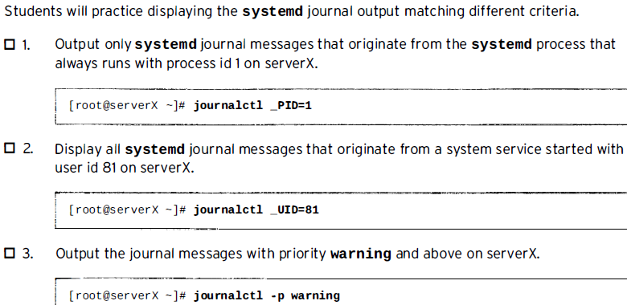
Practice: Finding Events With journalctl

Slide 22
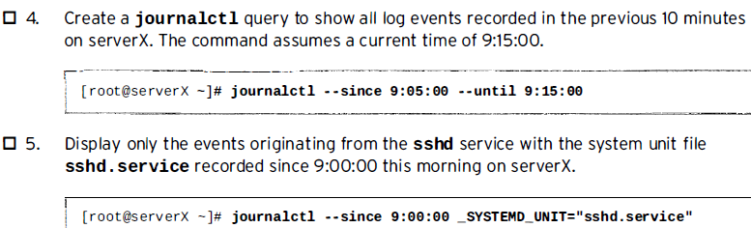
Practice: Finding Events With journalctl

Slide 23
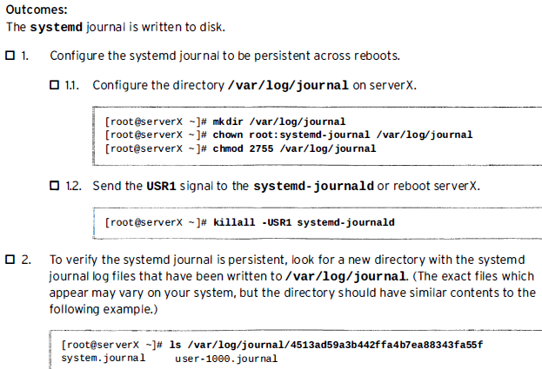
Practice: Configure a Persistent systemd
Journal

Slide 24
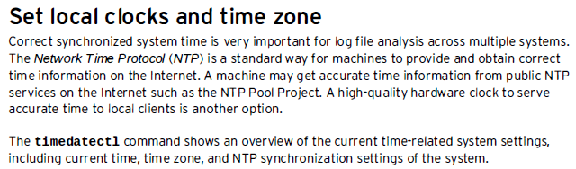

Maintaining Accurate Time

Slide 25
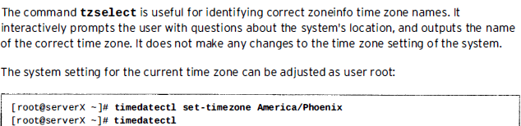
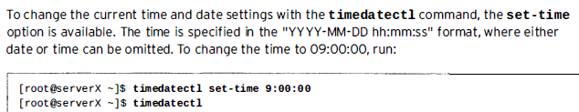
Maintaining Accurate Time

